Slide 1
SHORTNESS OF BREATH complaint of Aging seniors
A DIAGNOSTIC ALGORITHM AND MANAGEMENT

Slide 2
HUMAN BODY
1. SOPHISTICATED MARVELOUS CREATION OF ALMIGHTY
2. PERFECTLY RUN
3.GREAT COORDINATION OF DIFFERENT SUB-UNITS
4.SYNCHRONY OF SUPPLY AND DEMAND
5.OPERATIONAL ROUND THE CLOCK
6.NO VACATIONS OR BREAKS
7.REQUIRES DAILY MAINTENANCE

Slide 3
SUB-UNITS OF HUMAN BODY
NEUROLOGIC SYSTEM --Brain / Spinal cord and Peripheral Nerves
CARDIOVASCULAR SYSTEM – Heart, arteries, Veins
RESPIRATORY SYSTEM –Nostrils ,trachea ,bronchi, alveoli
GASTROINTESTINAL SYSTEM including Liver , spleen ,Pancreas
UROLOGIC SYSTEM-Kidney , Ureters, Bladder, Urethra
MUSCULO-SKELETAL SYSTEM- Upper body, lower body
ENDOCRINE SYSTEM- Pituitary, Thyroid, Parathyroid, Thymus, Adrenals,
REPRODUCTIVE SYSTEM Male and female
LYMPHATIC SYSTEM/HEMATOPOIETIC-Bone Marrow, Spleen, Lymph nodes

Slide 4
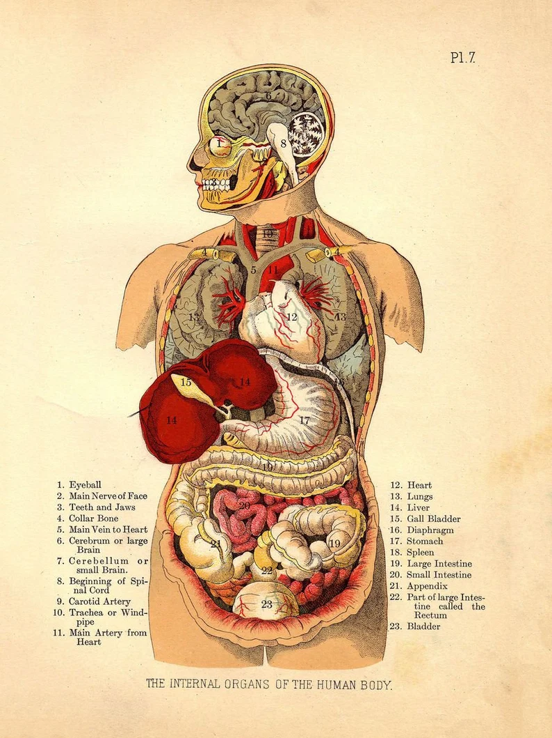
ANATOMY OF HUMAN BODY

Slide 5
NORMAL BREATHING
INVOLUNTARY PROCESS
CONTROLLED BY HIND BRAIN PONS/MEDULLA
DIAPHRAGM
INTERCOSTAL MUSCLES

Slide 6
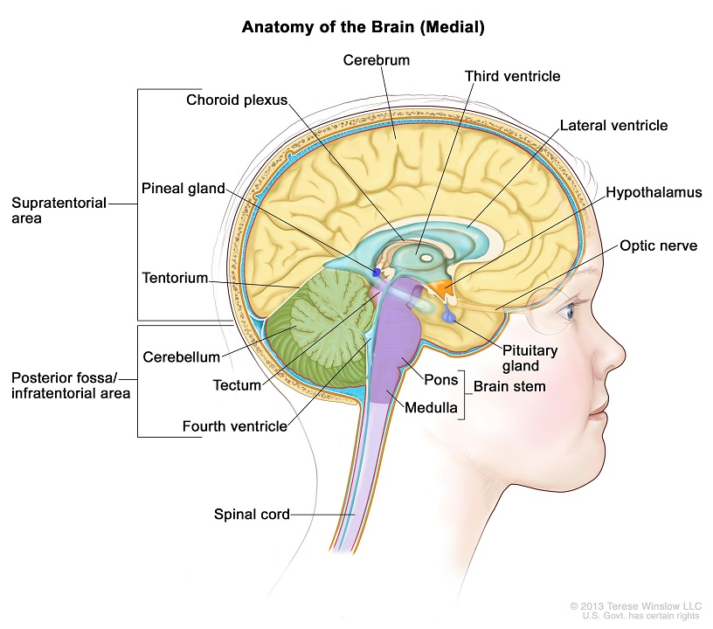
COMPUTER OF HUMAN MACHINE

Slide 7
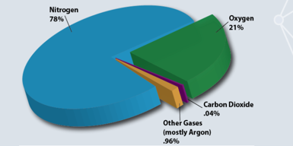
COMPONENTS OF NORMAL AIR

Slide 8
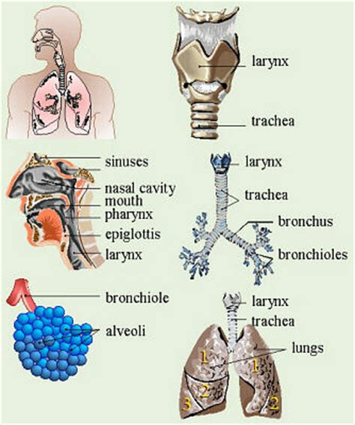
LUNGS AND UPPER AIRWAYS

Slide 9
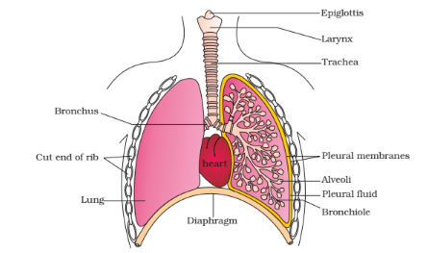
ANATOMY OF HUMAN AIRWAYS

Slide 10
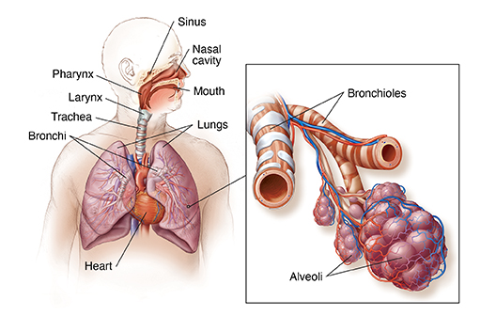
LUNG STRUCTURE

Slide 11
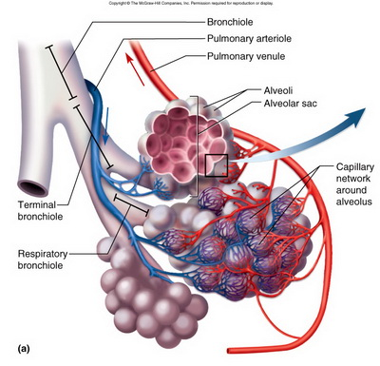
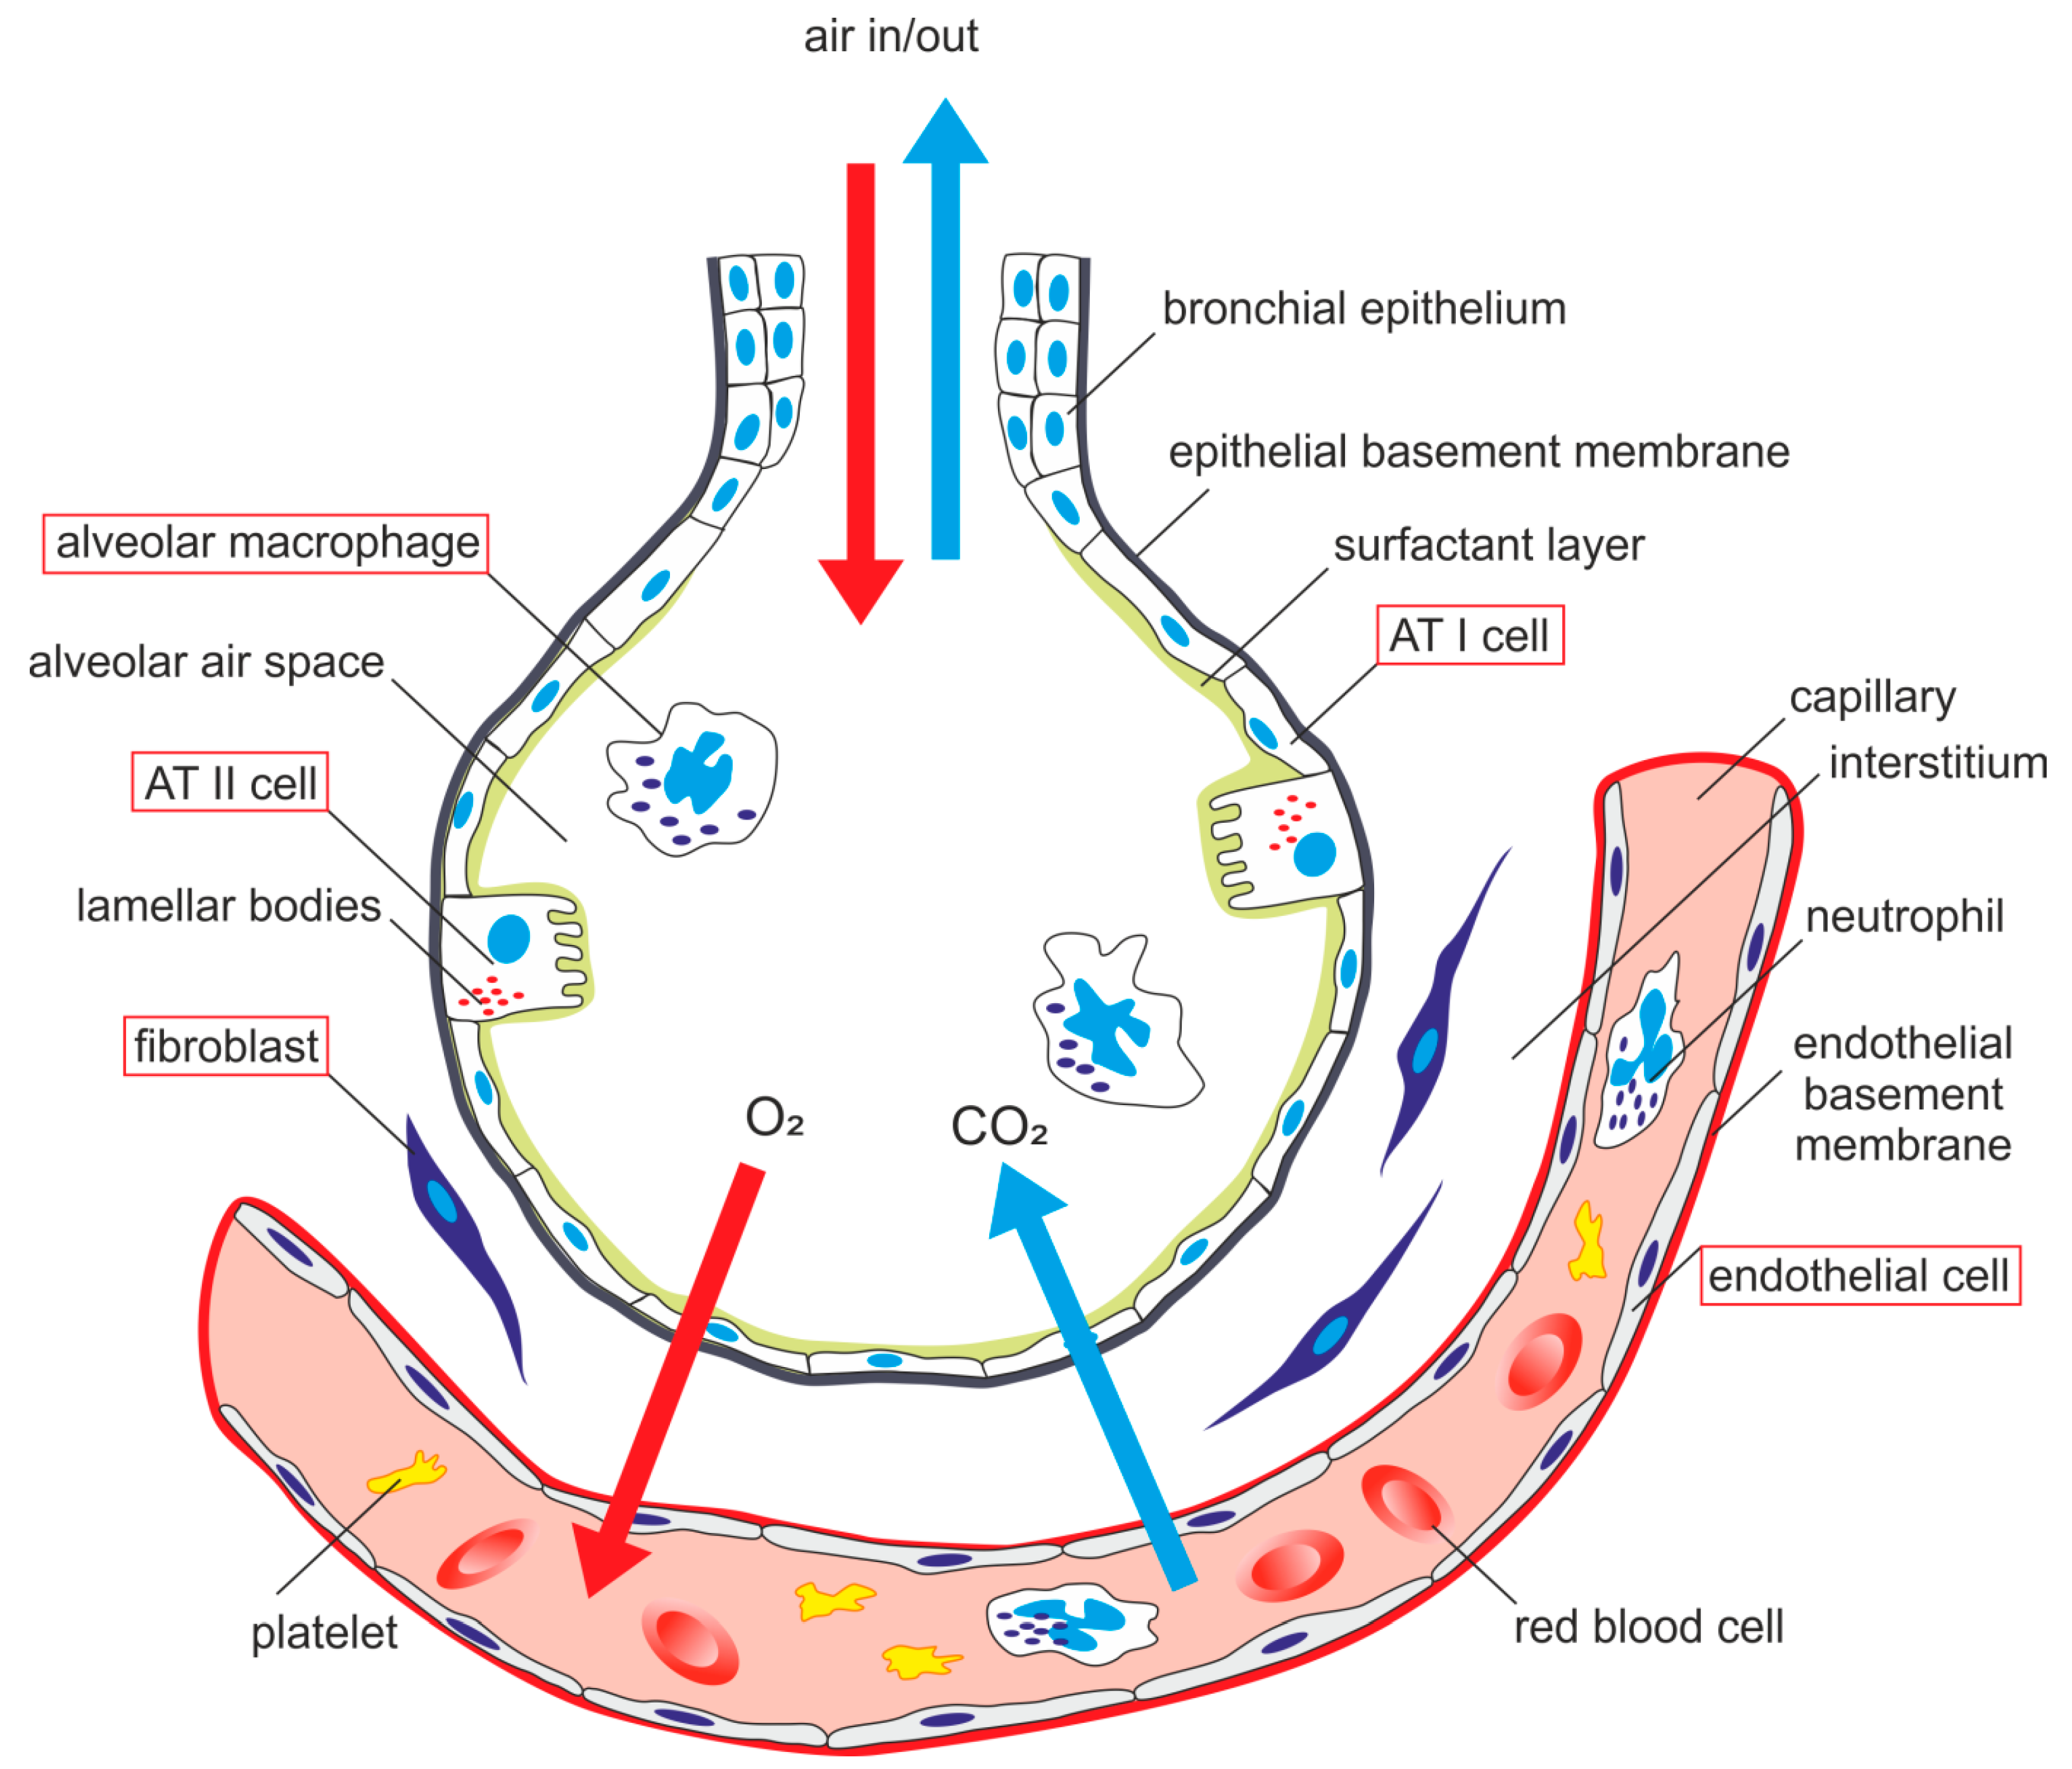
EXCHANGE OF OXYGEN AND CO2

Slide 12
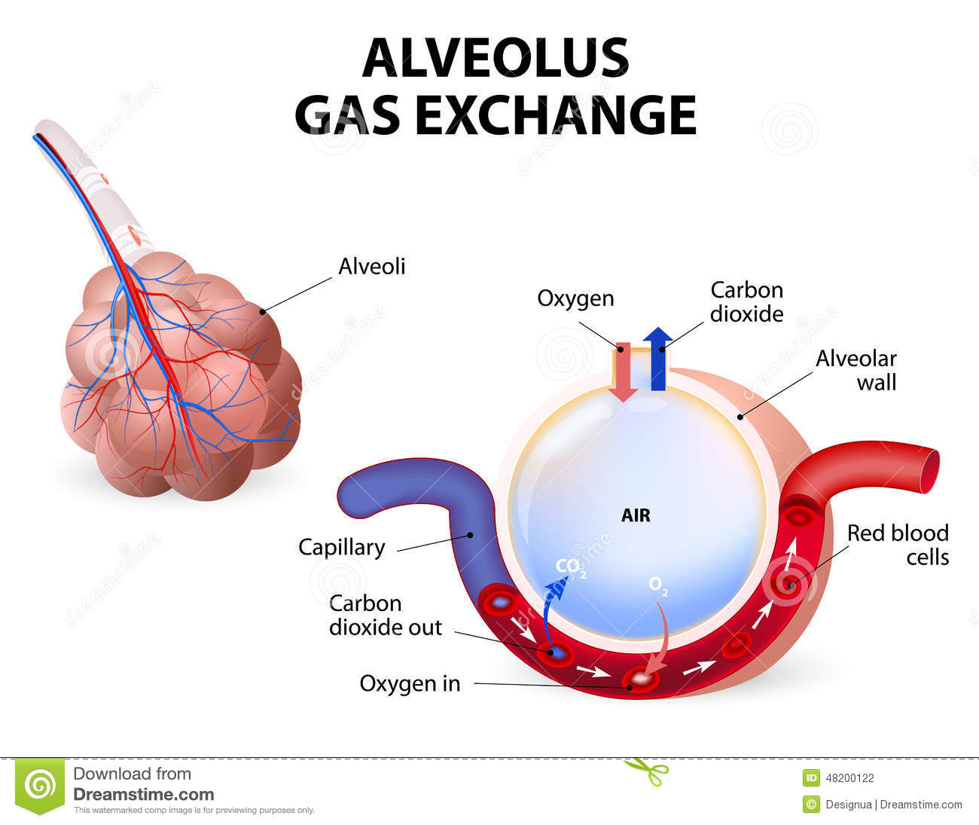
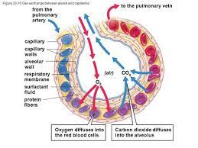
EXCHANGE OF GASES

Slide 13
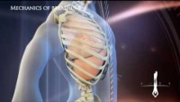
BREATHING ANIMATION

Slide 14
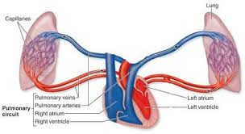
MARRIED COUPLE : HEART WEDS LUNGS

Slide 15
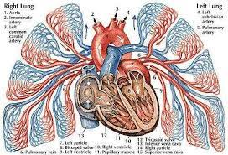
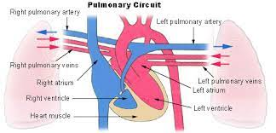
PUMP AND OXYGEN GENERATORS

Slide 16
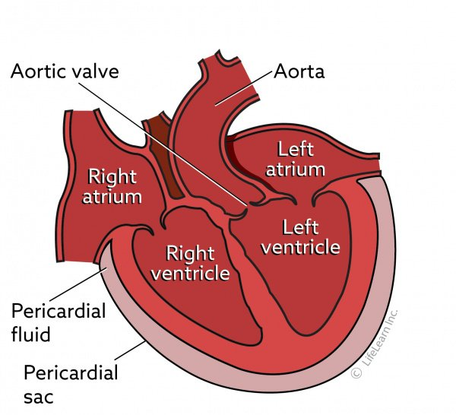
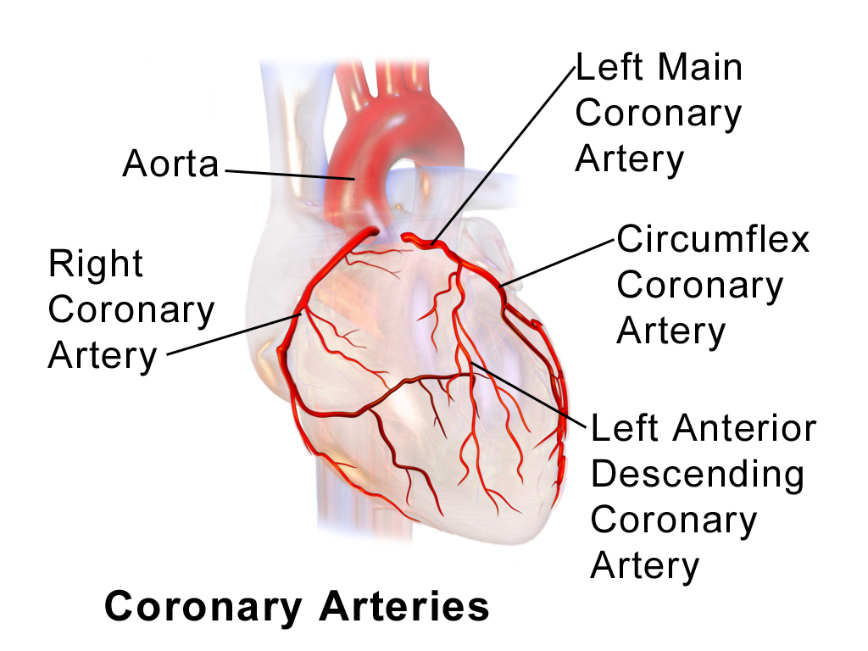
STRUCTURE OF THE HUMAN PUMP

Slide 17
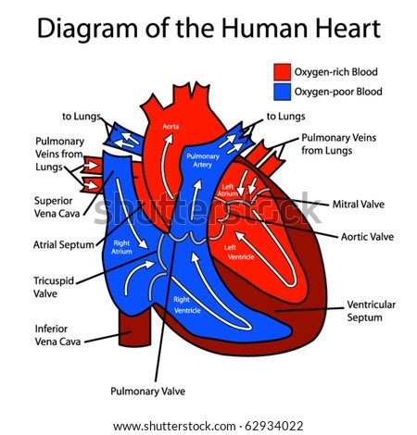
HUMAN HEART DIVISION

Slide 18
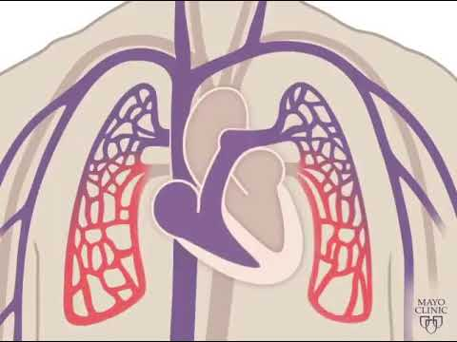
ARTERIAL AND VENOUS CIRCULATION

Slide 19
SHORTNESS OF BREATH
HEART AND LUNGS transport oxygen to your cells and remove carbon dioxide from cells
Any disease of Heart and lungs will cause Shortness of breath

Slide 20
CAUSES OF SHORTNESS OF BREATH
GENERALIZED WEAKNESS
DECONDITIONING
PROLONGED SICKNESS
ANEMIA
OBESITY
HEART PROBLEMS
LUNG PROBLEMS

Slide 21
CAUSES OF SHORTNESS OF BREATH
1.AIRWAY AND LUNG DISEASES
2.HEART AND PERICADIAL DISEASES
3.STRENUOUS EXERCISE
4.OBESITY
5.EXTREME TEMPERATURE CHANGES
6.HIGH ALTITUDE
7.BAD AIR QUALITY
8.ANEMIA
9.ANXIETY
10.DECONDITIONING

Slide 22
SUDDEN CAUSES OF SHORTNESS OF BREATH
ALLERGIC REACTION
ANXIETY ATTACK
CO POISONING
UPPER AIRWAY OBSTRUCTION
SUDDEN BLOOD LOSS
COPD EXACERBATION
COVID
PNEUMONIA
PNEUMOTHORAX
PULMONARY EMBOLISM
HEART ATTACK
HEART FAILURE
ARRYTHMIAS
CARDIAC TAMPONADE

Slide 23
LUNG PROBLEMS CAUSING SHORTNESS OF BREATH
CHEST WALL MUSCLE WEAKNESS
FLUID/AIR AROUND LUNGS
LUNG PARENCHYMA
TRACHEO -BRONCHIAL OBSTRUCTION
PUMONARY ARTERIAL OBSTRUCTION
PULMONARY VENOUS HYPERTENSION

Slide 24
HEART PROBLEMS CAUSING SHORTNESS OF BREATH
PERICARDIAL FLUID
MYOCARDIAL WEAKNESS
VALVULAR HEART DISEASE
CORONARY ARTERY DISEASE

Slide 25
CHRONIC CAUSES OF SHORTNESS OF BREATH
ASTHMA
COPD
DECONDITIONING
HEART DYSFUNCTION
OBESITY/POOR FITNESS
PLEURAL EFFUSION
INTERSTITIAL LUNG DISEASE

Slide 26
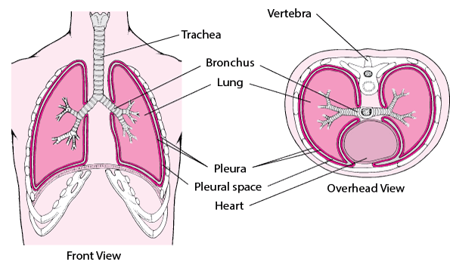
LUNG STRUCTURE

Slide 27
DIAGNOSIS OF SHORTNESS OF BREATH
PHYSICAL EXAMINATION --AWAKE AND ALERT
PULSE /OXIMETRY
RESPIRATIONS
BLOOD PRESSURE
TEMPERATURE
LUNG EXAMINATION
HEART EXAMINATION
ABDOMINAL EXAMINATION
VASCULAR EXAMINATION

Slide 28
DIAGNOSTIC TESTS FOR SHORTNESS OF BREATH
BLOOD WORK
URINE TEST
ECG
CHEST XRAY
CT SCANS OF CHEST /ABDOMEN
LUNG FUNCTION TESTS
ECHO
STRESS TEST

Slide 29
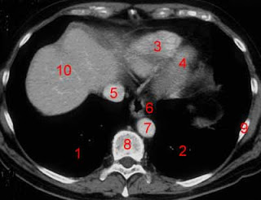
NORMAL ANATOMY SEEN IN CT SCAN CHEST

Slide 30
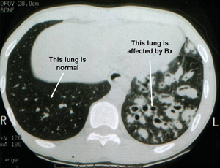
CT SCAN OF CHEST

Slide 31
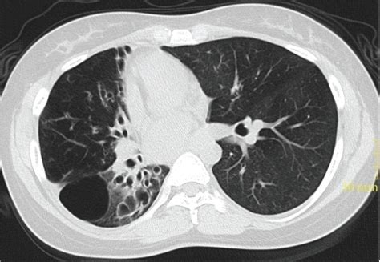
ABNORMAL CT SCAN OF CHEST

Slide 32
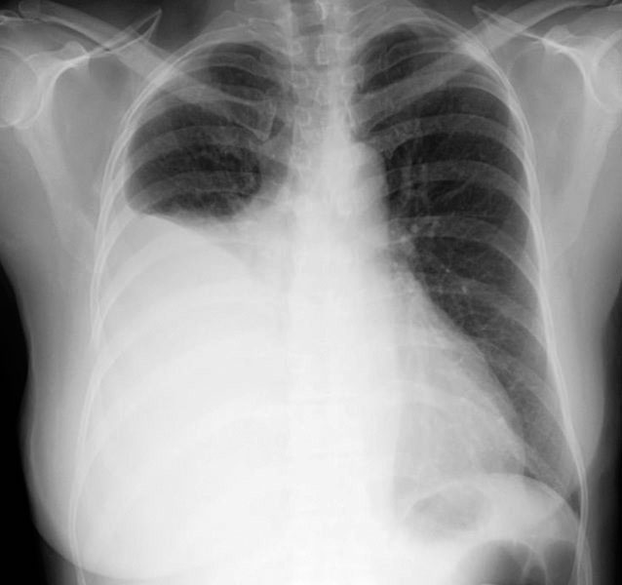
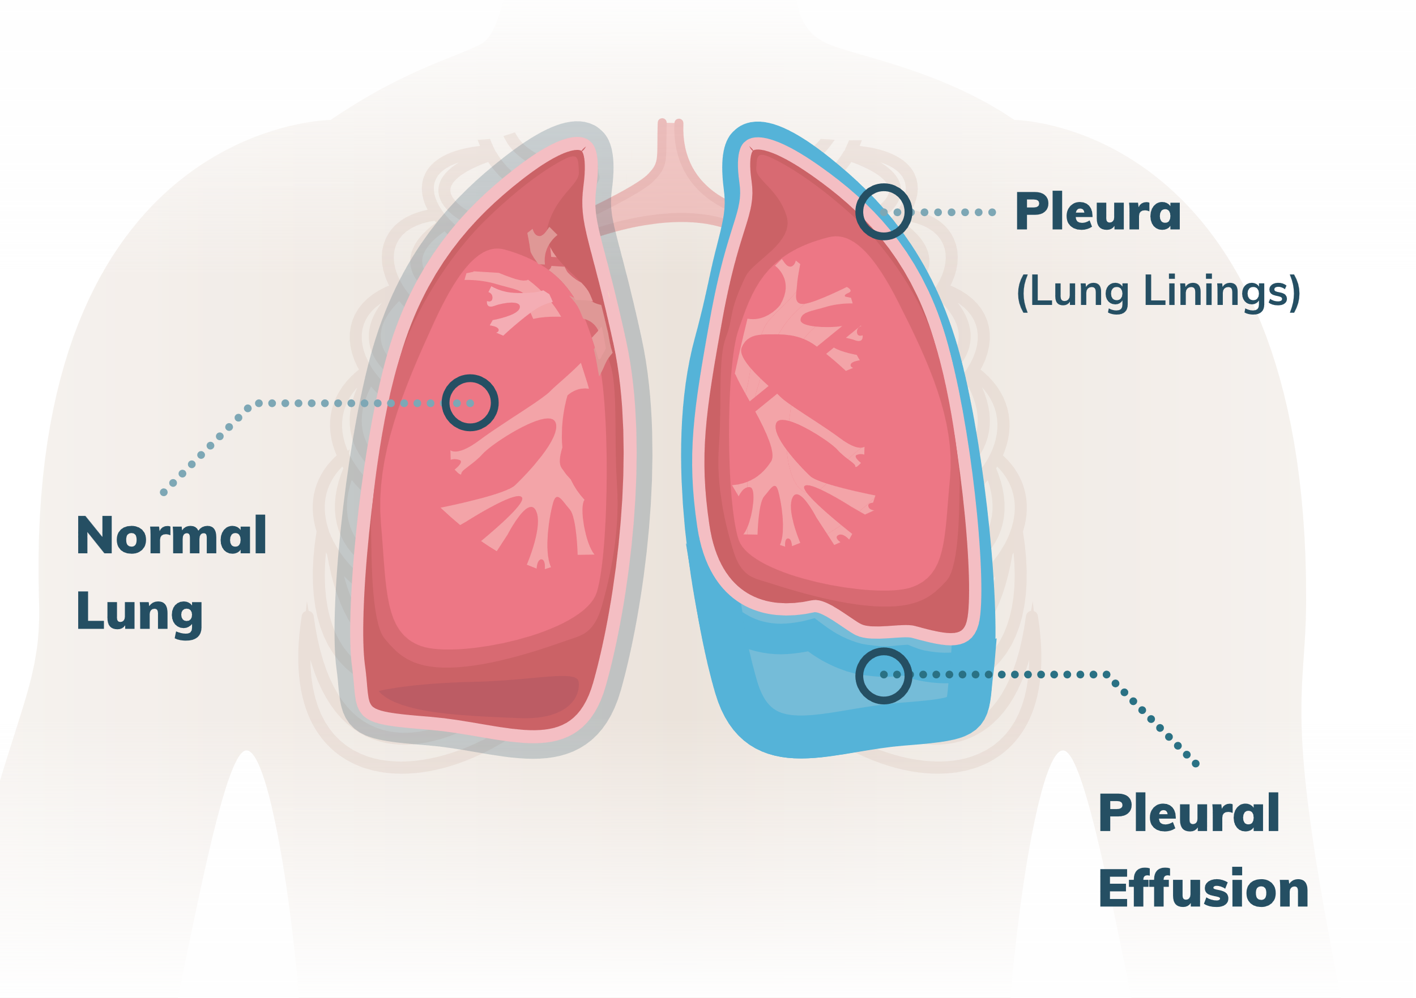
CAUSES OF SHORTNESS OF BREATH

Slide 33
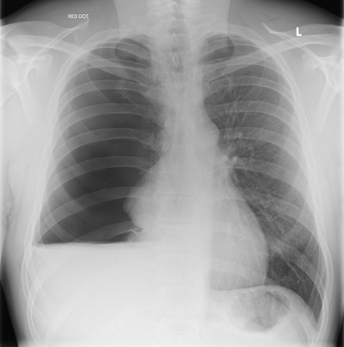
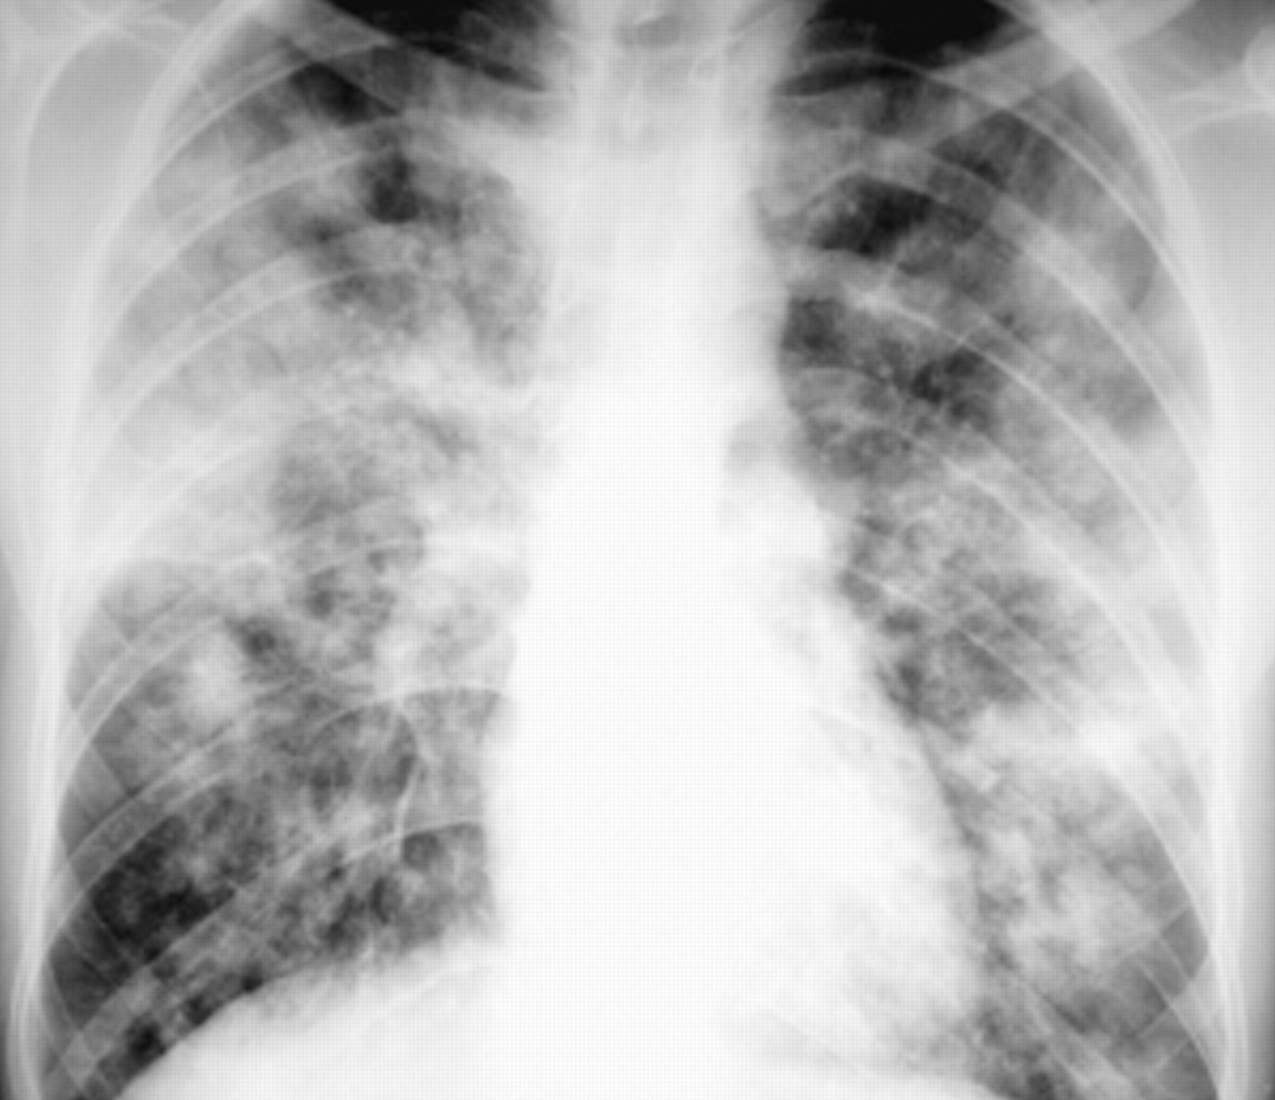
CAUSES OF HUFFING/PUFFING

Slide 34
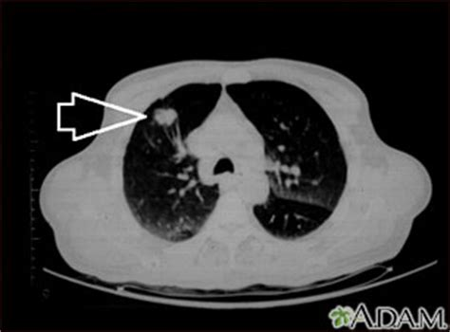
RIGHT LUNG TUMOR

Slide 35
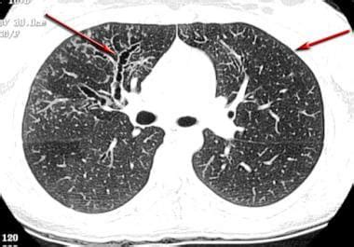
ABNORMAL CT SCAN OF CHEST

Slide 36
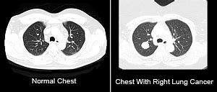
NORMAL AND ABNORMAL CT SCAN CHEST

Slide 37
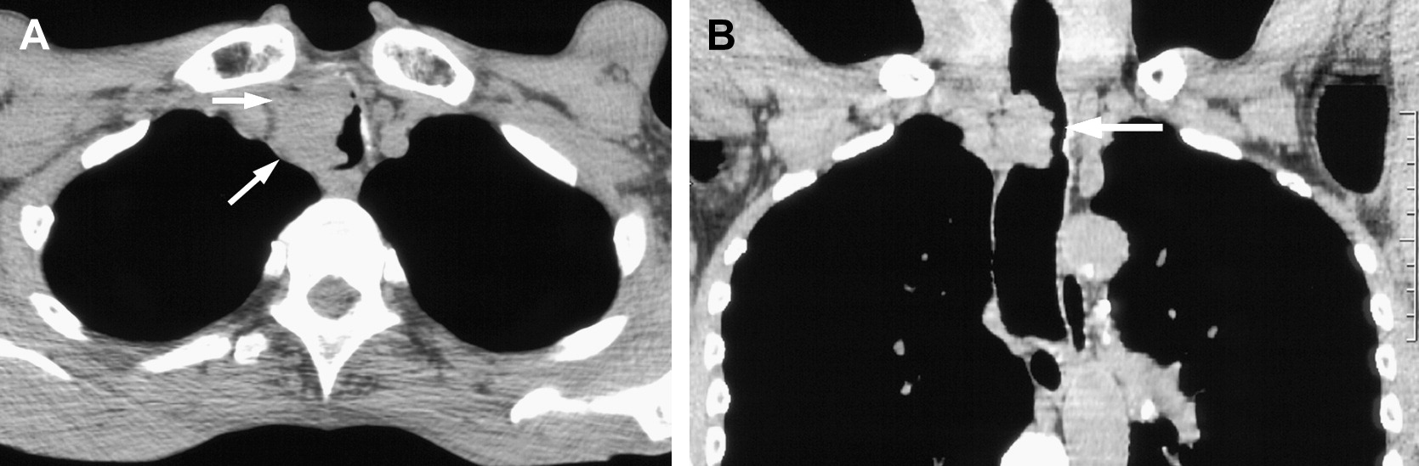
CAUSES OF SHORTNESS OF BREATH

Slide 38
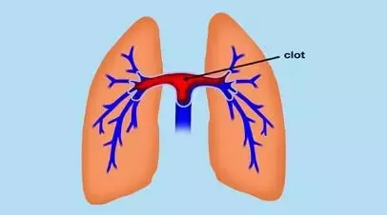
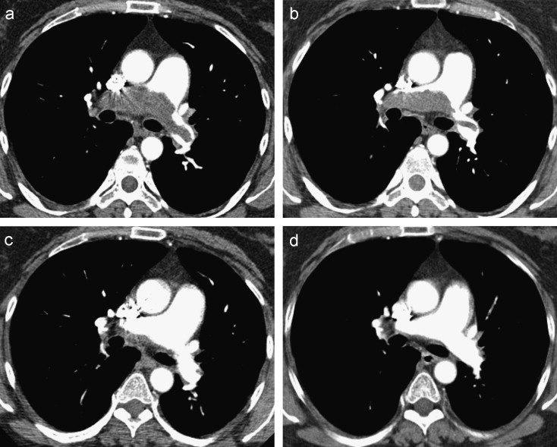
CAUSES OF SHORTNESS OF BREATH

Slide 39
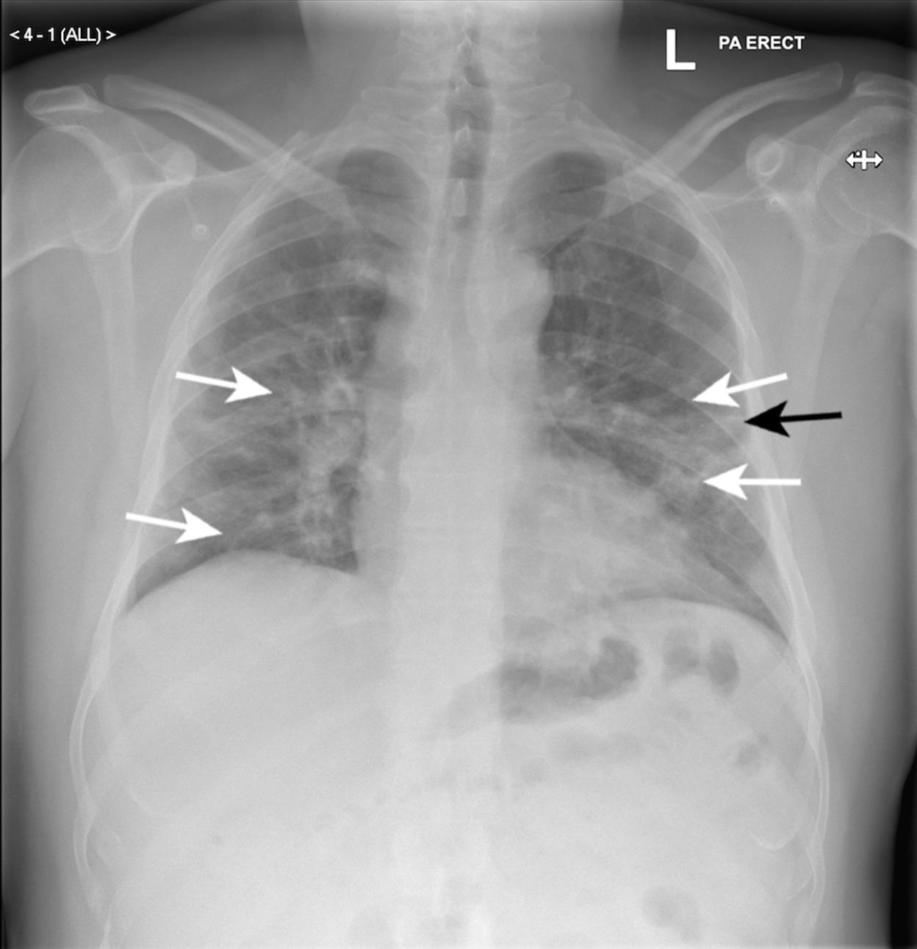
CAUSES OF SHORTNESS OF BREATH

Slide 40
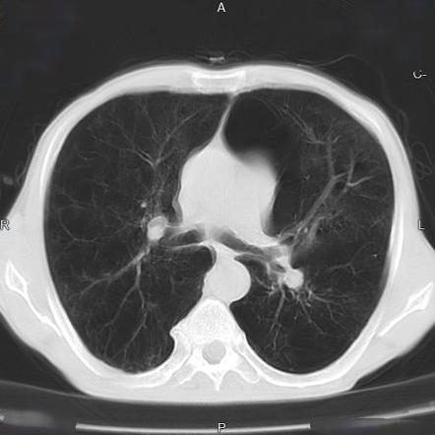
COPD /EMPHYSEMA

Slide 41
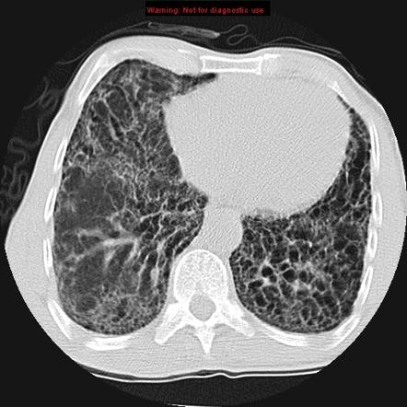
INTERSTITIAL LUNG DISEASE

Slide 42
WHEN TO GO TO HOSPITAL WITH SOB
BLUE FINGERS/BLUE LIPS
CHEST PAIN/HEAVY CHEST/SWEATING/NAUSEA
PALPITATIONS
HIGH FEVER
STRIDOR/WHEEZING
SWOLLEN ANKLES/SWOLLEN FEET
COUGHING OVER 3 WEEKS

Slide 43
TREATMENT OF SHORTNESS OF BREATH
DEPENDS ON CAUSE
STOP SMOKING
LIFE STYLE CHANGES with Diet and Exercise
WEIGHT CONTROL
CHECK WITH DOCTOR
REHABILITATION

